Slide 1
Capstone Engagement
Assessment, Analysis, and Hardening of a Vulnerable System Report Prepared by Paul Barrett

Slide 2
Table of Contents
This document contains the following sections:
01
Network Topology
02
Red Team: Security Assessment
03
Blue Team: Log Analysis and Attack Characterization
Hardening: Proposed Alarms and Mitigation Strategies
04

Slide 3
Preface
This report has been prepared for the purpose of identifying critical vulnerabilities on my client’s network. The targeted approach undertaken was to first use the Red Team to identify risks and penetrate in similar ways that a hacker might. This is a highly recommended approach to testing how your existing cybersecurity defenses stack up. Once sufficient vulnerabilities have been identified, the blue team then approaches the critical vulnerbilities and makes sure the recommended security measures will be effective after implementation.
Based on the above red team blue team assessment, mitigation strategies are then recommended.
Please refer to the Appendix at the end of this report for additional references and screenshots. These references can be identified as [APDX000]
Paul Barrett
SOC Analyst
27th November 2020

Slide 4
Network Topology
4

Slide 5
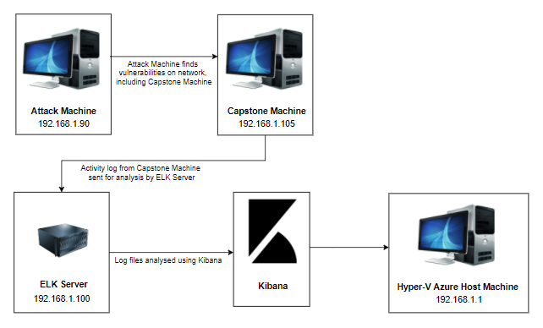
Network Topology
Network
Address Range: 192.168.1.0/24
Netmask: 255.255.255.0
Gateway: 10.0.0.76
Machines
IPv4: 19.168.1.1
OS: Windows 10
Hostname:
Azure Hyper-V ML-RefVm-684427
IPv4:192.168.1.90
OS: Linux 2.6.32
Hostname: Kali
IPv4: 192.168.1.100
OS: Linux
Hostname: ELK-Stack
IPv4: 192.168.1.105
OS: Linux
Hostname: Capstone
Capstone Analysis

Slide 6

Red Team
Security Assessment
6

Slide 7
Recon: Describing the Target
Nmap identified the following hosts on the network:
Hostname | IP Address | Role on Network
Hyper-V Azure machine ML-RefVm-684427 | 192.168.1.1 | Host Machine Cloud based
Kali | 192.168.1.90 | Attacking Machine
ELK stack | 192.168.1.100 | Network Monitoring Machine running Kibana
Capstone | 192.168.1.105 | Target Machine Replicating a vulnerable server

Slide 8
Vulnerability Assessment
The assessment uncovered the following critical vulnerabilities in the target:
Vulnerability | Description | Impact
Port 80 open with public access CVE-2019-6579 | Open and unsecured access to anyone attempting entry using Port 80. | Files and Folders are readily accessible. Sensitive (and secret) files and folders can be found.
Root accessibility | Authorization to execute and command, and access any resource on the vulnerable device. | Vulnerabilities can be leveraged. Extensive potential Impact to any connected network.
Simplistic Usernames | First name, short names, or similar information can be easily socially engineered | ‘Hannah’, ‘Ryan’ and ‘ashton’ are all predictable names that can be discovered by social engineering. In conjunction with a simple/ weak password, file/folder access can be attained.
Weak Passwords | Commonly used passwords such as simple words, and the lack of password complexity, such as the inclusion of symbols, numbers and capitals. | System access could be discovered by social engineering. https://thycotic.com/resources/password-strength-checker/ suggests that ‘Leopoldo’ could be cracked in 21 seconds by a computer.

Slide 9
Vulnerability Assessment
Vulnerability | Description | Impact
Ability to discover password by Brute force CVE-2019-3746 | When an attacker uses numerous username and password combinations to access a device and/or system. | Easy system access by use of brute force with common password lists such as rockyou.txt by programs such as ‘John the ripper’, Hydra, Medusa, Ophcrack, Brutus and ‘Cain and Able’.
Hashed Passwords | If a password is not salted it can be cracked via online tools such as www.crackstation.net or programs such as hashcat. | Once the password is cracked, and if a user name is already known, a hacker can access system files.
Directory Indexing vulnerability CWE-548 | Attacker can view and download content of a directory located on a vulnerable device. CWE-548 refers to an informational leak through directory listing. | The attacker can gain access to source code, or devise other exploits. The directory listing can compromise private or confidential data.
LFI Vulnerability | LFI allows access into confidential files on a vulnerable machine. | An LFI vulnerability allows attackers to gain access to sensitive credentials. The attacker can read (and sometimes execute) files on the vulnerable machine.

Slide 10
Vulnerability Assessment
Vulnerability | Description | Impact
WebDAV Vulnerability | Exploit WebDAV on a server and Shell access is possible. | If WebDAV is not configured properly, it can allow hackers to remotely modify website content.
Other user’s credentials found when logging on with different user CVE-2020-24227 | Storing a user name and/or password in plain text that is not encrypted. | Evidence showed that Ashton had Ryan’s name and password hash stored. This enabled further penetration into the system without extensive social engineering. [APDX004] [APDX006]
ETCD version subject to pre-3.3.23 vulnerability CVE-2020-15115 | The current ETCD version installed is 3.2.17 which makes etcd vulnerable. (etcd is an open source key-value store used to hold and manage critical systems information) | This may allow an attacker to guess or brute-force users' passwords with little computational effort. [APDX005]

Slide 11
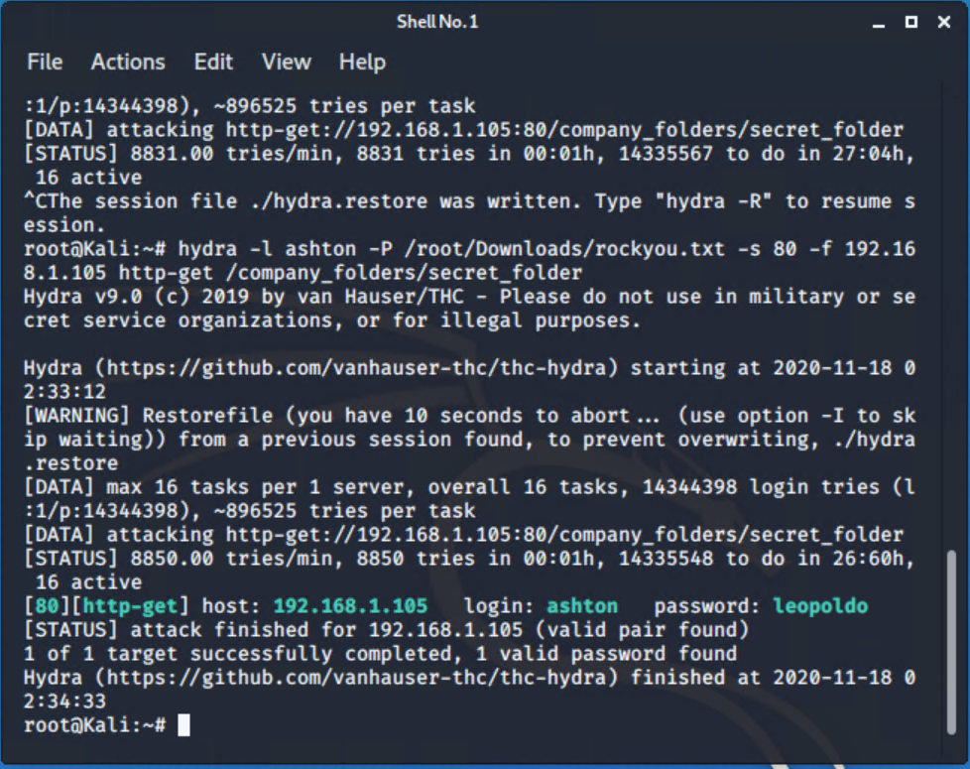
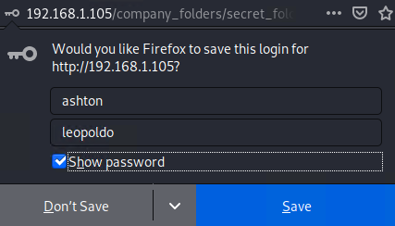
Exploitation: Brute Force Password
01
03
Tools & Processes
I used Hydra which is already preinstalled on Kali Linux. I also required a password list – in this case I used rockyou.txt
Command: $ hydra -l ashton -P /root/Downloads/rockyou.txt -s 80 -f 192.168.1.105 http-get /company_folders/secret_folder
02
Achievements
The exploit provided me with confirmation of the login name ‘ashton’ as well as the password ‘leopoldo’.
User access
achieved.

Slide 12
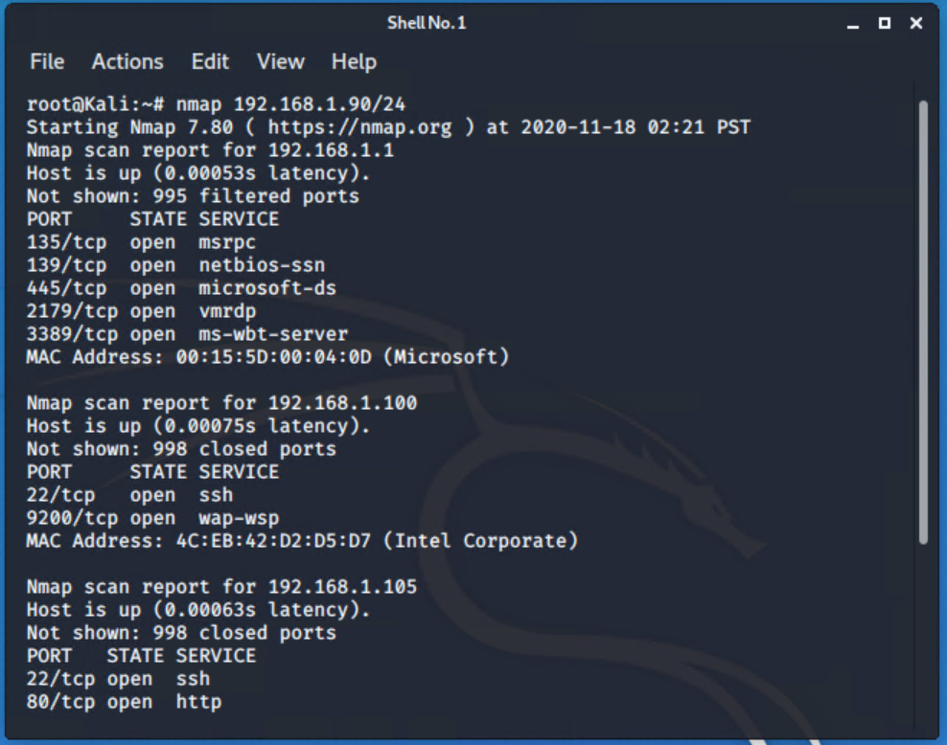
Exploitation: Port 80 Open to Public Access
03
01
Tools & Processes
I used nmap to scan for open ports on the target machine.
02
Achievements
Nmap scanned 256 IP addresses: I found 4 hosts up:
Port 22 and 80 was of interest to me.

Slide 13
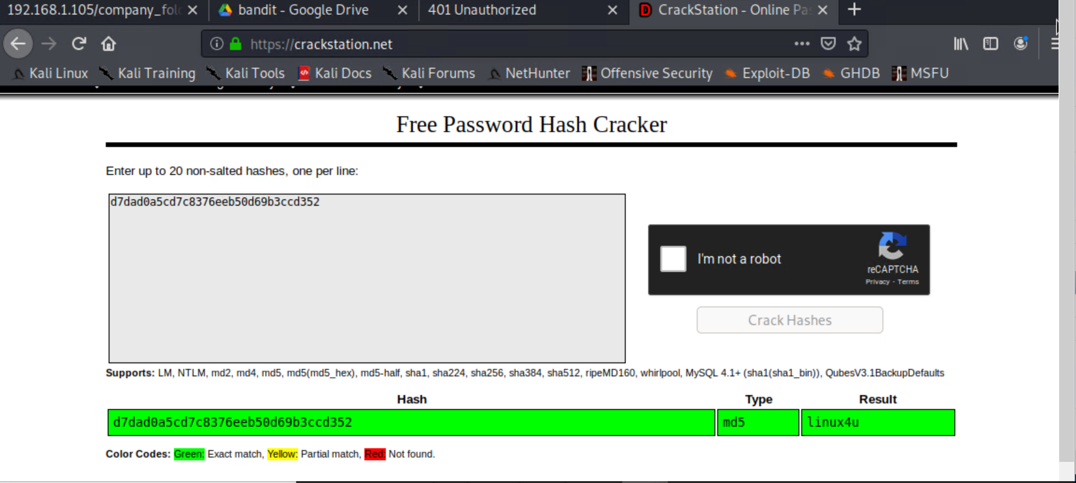
Exploitation: Hashed Passwords
01
02
Tools & Processes
I used the website crackstation.net to crack the hashed password.
Achievements
The password ‘linux4u’ was used in conjunction with username Ryan to access the /webdav folder.
03

Slide 14
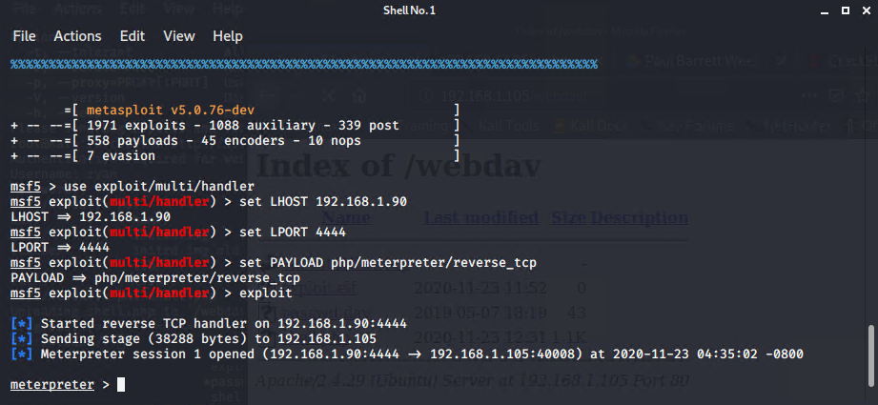
Exploitation: LFI vulnerability
01
02
Tools & Processes
I used msfvenom and meterpreter to deliver a payload onto the vulnerable machine (the capstone server)
Achievements
Using the multi/handler exploit I could get access to the machine’s shell.
03

Slide 15

Blue Team
Log Analysis and Attack Characterization
15

Slide 16

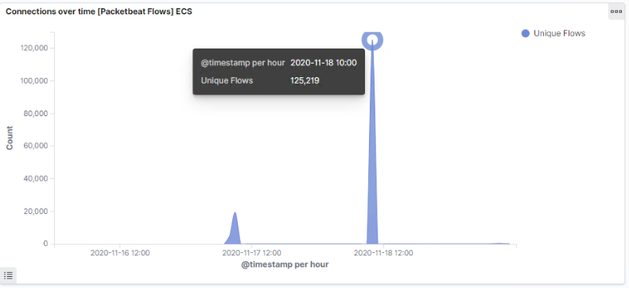
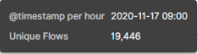
Analysis: Identifying the Port Scan
The port scan started on November 17, 2020 at approximately 0900hrs
125,219 connections occurred at the peak, the source IP was 192.168.1.90
The sudden peaks in network traffic indicate that this was a port scan.

Slide 17
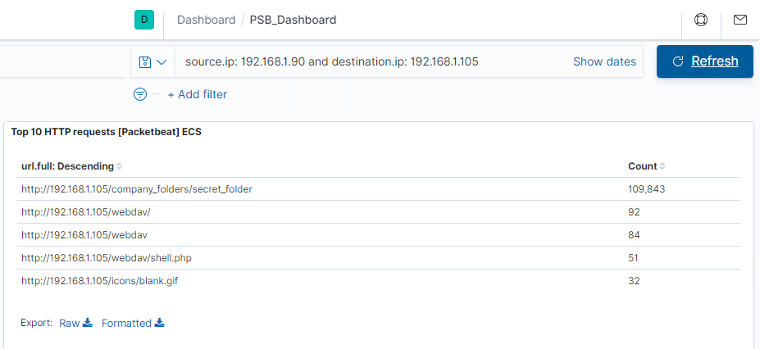
Analysis: Finding the Request for a Hidden Directory
The request started at 0700hrs on 17th November 2020
109,843 requests were made to access the /secret_folder
The /secret_folder contained a hash that I could use to access the system using another employee’s credentials (Ryan)
The /secret_folder also allowed me to upload a payload, thus exploiting other vulnerabilities

Slide 18
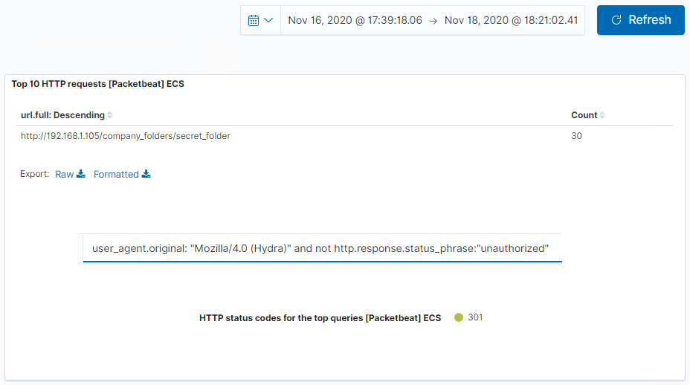
Analysis: Uncovering a Brute Force Attack
109,843 requests were made in the attack to access the /secret_folder.
30 attacks were successful. 100% of these attacks returned a 301 HTTP status code “Moved Permanently”.

Slide 19
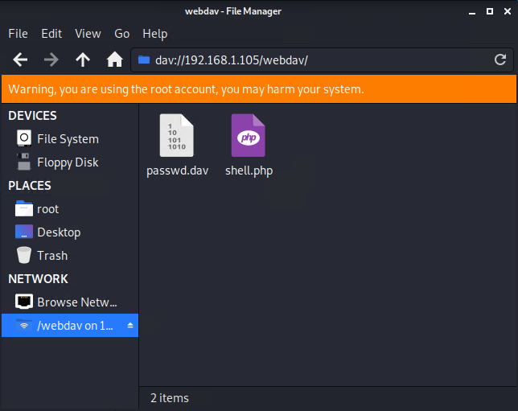
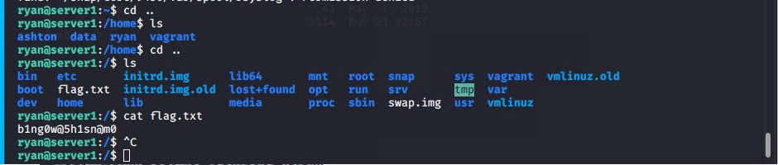
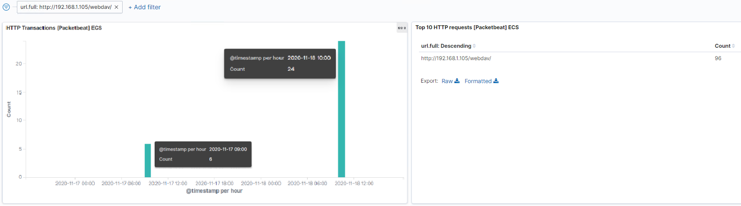
Analysis: Finding the WebDAV Connection
96 requests were made to access the /webdav directory.
The primary requests were for the passwd.dav and shell.php files.
Flag Found:

Slide 20
Blue Team
Proposed Alarms and Mitigation Strategies
20

Slide 21
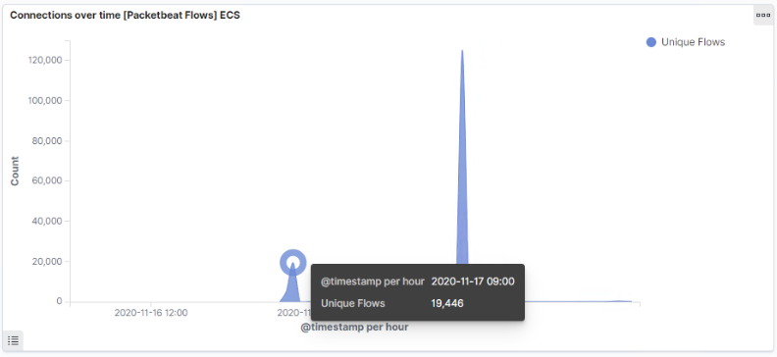
Mitigation: Blocking the Port Scan
I recommend an alert be sent once 1000 connections occur in an hour.
Regularly run a system port scan to proactively detect and audit any open ports.
Set server iptables to drop packet traffic when thresholds are exceeded
Ensure the firewall is regularly patched to minimise new zero-day attacks.
Ensure the firewall detects and cuts off the scan attempt in real time.

Slide 22
Mitigation: Finding the Request for the Hidden Directory
To detect unauthorized access requests for hidden folders and files, I would set an alert when these requests occur.
I would recommend a threshold of maximum 5 attempts per hour that would trigger an alert to be sent.
Highly confidential folders should not be shared for public access
Rename folders containing sensitive/private/company critical data
Encrypt data contained within confidential folders
Review IP addresses that cause an alert to be sent: either whitelist or block the IP addresses.

Slide 23
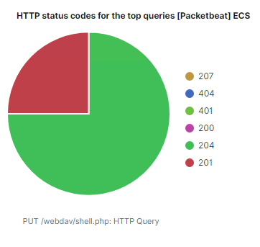
Mitigation: Preventing Brute Force Attacks
A HTTP 401 Unauthorized client error indicates that the request has ot been applied because it lacks valid authentication credentials for the target resource.
I would detect future brute force attacks by setting an alarm that alerts if a 401 error is returned.
I would create a policy that locks out accounts for 30 minutes after 5 unsuccessful attempts.
I would create a password policy that requires password complexity. I would compare the passwords to common password lists, and prevent users from reusing historical passwords.
I would create a list of blocked IP addresses based on IP addresses that have 30 unsuccessful attempts in 6 months. If the IP address happens to be a staff member, re-education may be required.
The threshold I would set to activate this alarm would be when 10 errors are returned.

Slide 24
Mitigation: Detecting the WebDAV Connection
First, I would create a Whitelist of trusted IP Addresses. Review this list every 6 months: ‘do they really need access?’
On HTTP GET request, I would set an alarm that activates on any IP address trying to access the webDAV directory outside of those trusted IP addresses.
The threshold I would set to activate this alarm would be when any HTTP PUT request is made.
Creating a whitelist of trusted IP addresses and ensure my firewall security policy prevents all other access. [APDX001] [APDX002]
Assuming my IP address is 192.168.1.1, within Ubuntu I would run the following command:
$ iptables -I INPUT -s 192.168.1.1 -p tcp -m multiport --dports 80,443 -j ACCEPT
In conjunction with other mitigation strategies, I would ensure that any access to the WebDAV folder is only permitted by users with complex username and passwords.

Slide 25
Mitigation: Identifying Reverse Shell Uploads
I recommend that an alert be set for any traffic attempting to access port 4444. The threshold for the alert to be sent is when one or more attempt is made.
I recommend setting an alert for any files being uploaded into the /webDAV folder. The threshold for the alert to be sent is when one or more attempt is made.
Block all IP addresses other than whitelisted IP addresses (because reverse shells can be created over DNS, this action will only limit the risk of reverse shell connections, not eliminate the risk)
Set access to the /webDAV folder to read only to prevent payloads from being uploaded
Ensure only necessary ports are open
[APDX003]

Slide 26
Assessment Summary
The Red Team uncovered the following vulnerabilities:
Accessed the system via HTTP Port 80
Found Root accessibility
Found the occurrence of simplistic usernames and weak passwords
Brute forced passwords to gain system access
Cracked a hashed password to gain system access and use a shell script
Identified a LFI vulnerability
Identified Directory Indexing vulnerability CWE-548
The Blue Team also:
Confirmed that a port scan occurred
Found requests for a hidden directory
Found evidence of a brute force attack
Found requests to access critical system folders and files
Identified a WebDAV vulnerability
It is important to note that the above report is not an exhaustive review of the client’s I.T. systems or security policies. I have identified 11 vulnerabilities and provided mitigation strategies for several of them. What I have made clear however is that vulnerabilities can and will always be found. If you are a company executive, you should be constantly asking yourself: How prepared is my company for dealing with a cybersecurity breach?
Keep this fact in mind: It is not if you will get hacked, it is WHEN you will get hacked.
I encourage you to take steps to minimising the impacts of when this occurs.

Slide 27
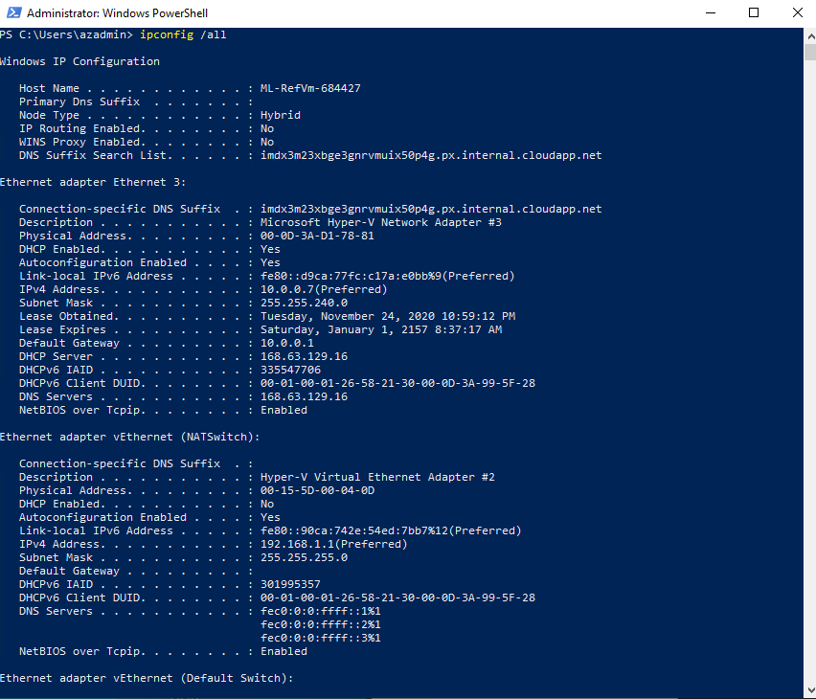
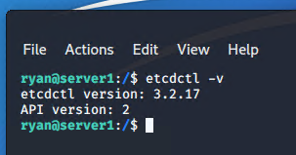
Appendix
The following pages are a list of references and relevant screenshots.
APDX001
APDX002
https://support.stackpath.com/hc/en-us/articles/360001074623-How-To-Whitelist-StackPath-IP-Blocks-in-IPTables
APDX003
http://help.sonicwall.com/help/sw/eng/9530/26/2/3/content/Application_Control.065.23.htm
APDX004
https://www.passcamp.com/blog/dangers-of-storing-and-sharing-passwords-in-plaintext/
APDX005

Slide 28
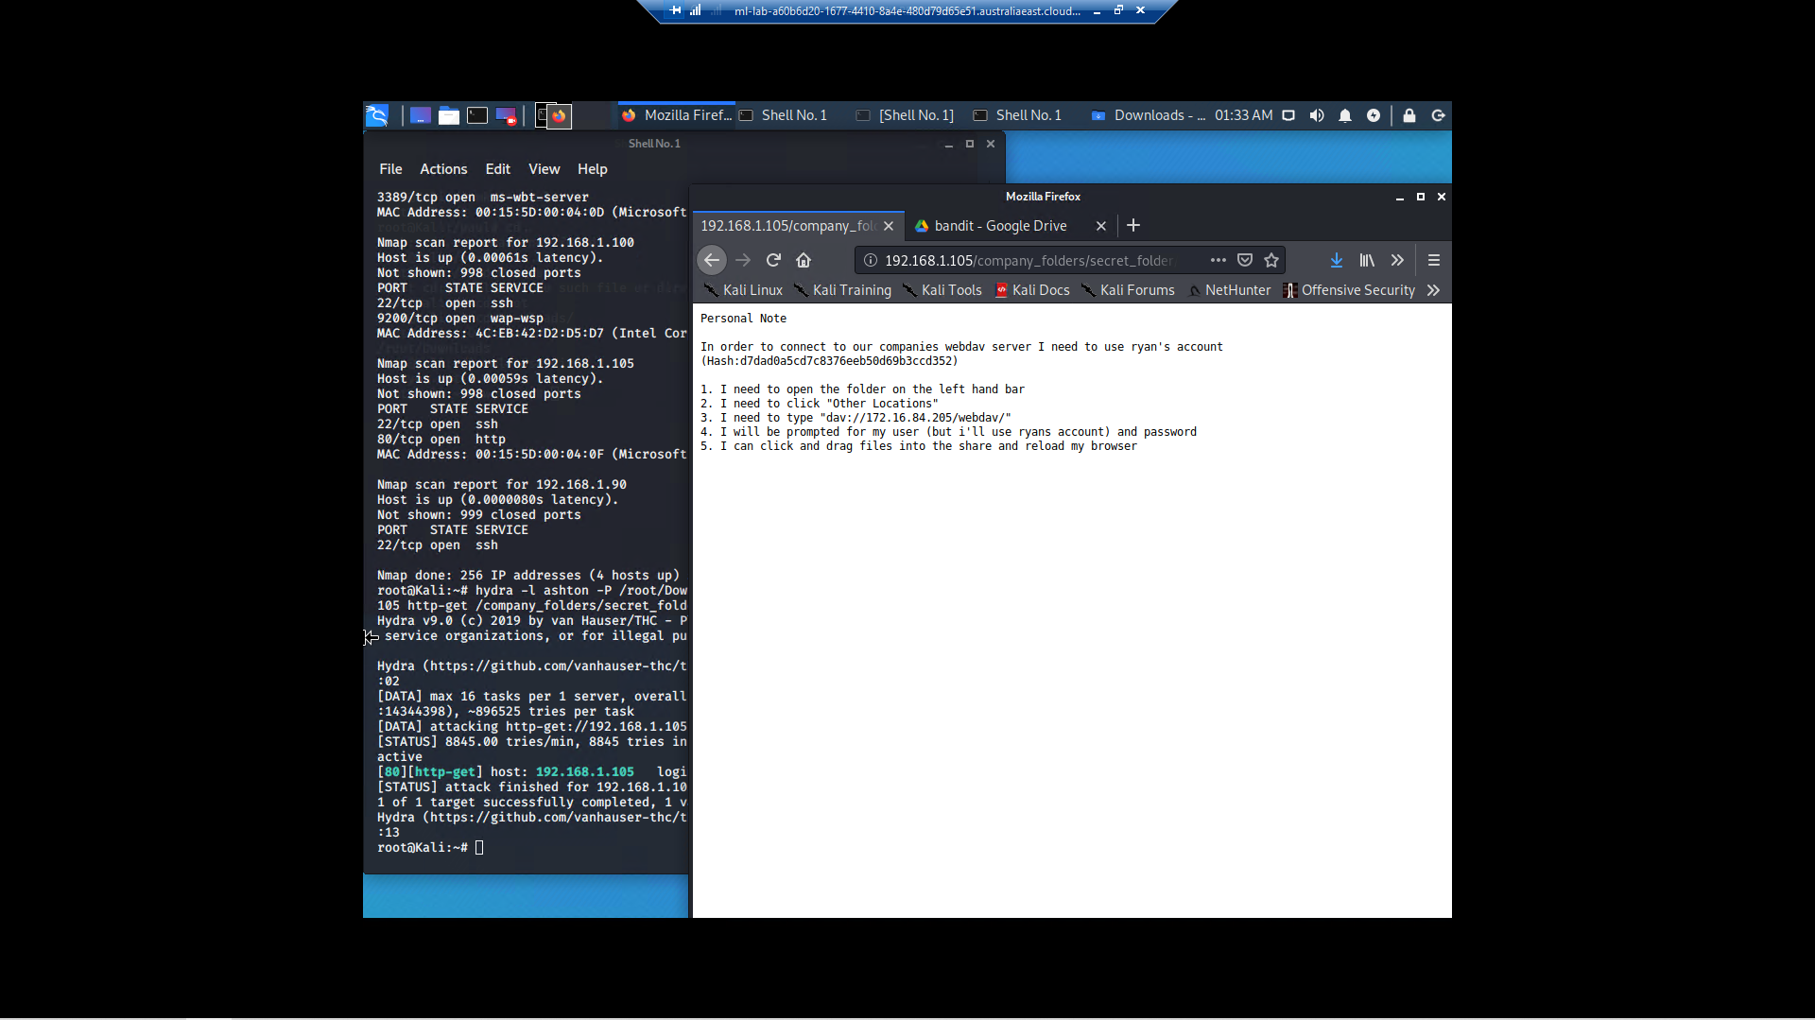
Appendix
APDX006

Slide 29

Report End

